Slide 1
Employee Data Analysis using Excel
STUDENT NAME: SARINA D S
REGISTER NO: 305C284857CID9FA6E6488D383B76959, 312208826
DEPARTMENT: B.COM[GENERAL]
COLLEGE: MEENAKSHI COLLEGE FOR WOMEN

Slide 2
PROJECT TITLE
Employee Performance Analysis
Based On Department, Gender and FTE using Excel

Slide 3


AGENDA
Problem Statement
Project Overview
End Users
Our Solution and Proposition
Dataset Description
Modelling Approach
Results and Discussion
Conclusion
3/21/2024 Annual Review

Slide 4

PROBLEM STATEMENT
Full-time equivalent (FTE) is a unit of measurement that helps companies understand their workforce's capacity and plan their budgets. It compares the work of part-time employees to full-time employees to determine the number of full-time hours worked by all employees

Slide 5

PROJECT OVERVIEW
Data analysis will support you to identify high-performing programs, service areas, and people. Once you identify your high-performers, you can study them in order to develop strategies to assist programs, service areas and people that are low-performing
.

Slide 6

WHO ARE THE END USERS?
● HUMAN RESOURCE DEPARTMENTS
● MANAGEMENT AND LEADERSHIP
● TEAM LEADERS AND SUPERVISORS
● EMPLOYEES
● EXECUTIVE LEADERSHIP
● BUSINESS ANALYSTS
● RECRUITERS

Slide 7

OUR SOLUTION AND ITS VALUE PROPOSITION
FILTERING- REMOVE VALUES
PIVOT TABLE - SUMMARY OF
EMPLOYEE PERFORMANCE
BAR DIAGRAM - FINAL REPORT

Slide 8
Dataset Description
● EMPLOYEE DATA SET- NAN MUDHALVAN PORTAL
● 9 FEATURES IN EXCEL:
EMPLOYEE ID- ALPHANUMERIC(TEXT)
NAME- ALPHABETICAL(TEXT)
GENDER- ALPHABETICAL(TEXT)
DEPARTMENT - ALPHABETICAL(TEXT)
SALARY - NUMERICAL
START DATE - ALPHANUMERIC(TEXT)
FTE- NUMERICAL
EMPLOYEE TYPE- ALPHABETICAL(TEXT)
EMPLOYEE LOCATION- ALPHABETICAL(TEXT)
● 3 FEATURES USED:
DEPARTMENT - ALPHABETICAL(TEXT)
FTE- NUMERICAL
GENDER- ALPHABETICAL(TEXT)

Slide 9

THE "WOW" IN OUR SOLUTION
Once you identify your high-performers, you can study them in order to develop strategies to assist programs, service areas and people that are low-performing.
3/21/2024 Annual Review
9

Slide 10
MODELLING
● STEP -1
DOWNLOAD THE EMPLOYEE DATASET
AND OPEN THE EMPLOYEE DATASET IN EXCEL.
● STEP -2
SELECT THE ENTIRE DATA AND CLICK
ON DATA AND CLICK ON FILTER OPTION.
● STEP -3
FILTER FTP FROM A TO Z ORDER.
● STEP -4
SELECT THE ENTIRE DATA AND CLICK
ON INSERT AND CLICK ON PIVOT TABLE TO
CREATE PIVOT TABLE.
10

Slide 11
● STEP -5
DRAG THE NEEDED DATA AND CREATE A
PIVOT TABLE.
● STEP -6
SELECT THE PIVOT TABLE AND CLICK ON
INSERT.
● STEP-7
NOW CLICK ON THE CHART THAT YOU
WANT.
● STEP -8
THE CHART IS CREATED

Slide 12
RESULTS 1.TABLE
Sum of FTE | Column Labels
Row Labels | Marketing | Product Management | Sales | Training | Grand Total
Female | 3.7 | 9.6 | 3.3 | 9.9 | 26.5
Male | 4.9 | 8 | 4 | 6 | 22.9
(blank) |  |  |  | 1 | 1
Grand Total | 8.6 | 17.6 | 7.3 | 16.9 | 50.4
12

Slide 13
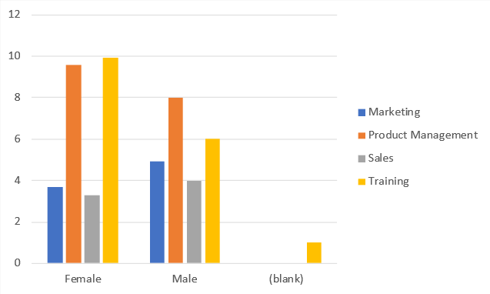
2. BAR DIAGRAM

Slide 14
conclusion
Data summaries usually present the dataset average (mean, median, and/or mode); standard deviation from mean or interquartile range; how the data is distributed across the range of data (for example is it skewed to one side of the range); and statistical dependence (if more than one variable was captured in the dataset). Data summaries may be presented in numerical text and/or in tables, graphs, or diagrams.

